Slide 1
Trillingstijd en frequentie
Trillingstijd de tijd van één trilling in sec.
T in s Frequentie het aantal trillingen in 1 seconde.
f in Hz

Slide 2
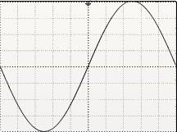
1 trilling in 1s f = 1 Hz
T = 1 s $f=\frac{1}{T}$ $f=\frac{1}{1 s}=1 Hz$
f = 1 Hz $T=\frac{1}{f}$ $T=\frac{1}{1 Hz}=1 s$
1s

Slide 3
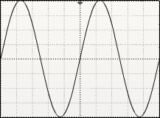
2 trillingen in 1s f = 2 Hz
2 trilling
T = 0,5 s $f=\frac{1}{T}$ $f=\frac{1}{0,5 s}=2 Hz$
f = 2 Hz $T=\frac{1}{f}$ $T=\frac{1}{2 Hz}=0,5 s$
1s

Slide 4
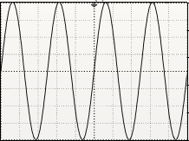
4 trillingen in 1s f = 4 Hz
4 trilling
4 trilling
T = 0,25 s $f=\frac{1}{T}$ $f=\frac{1}{0,25 s}=4 Hz$
f = 4 Hz $T=\frac{1}{f}$ $T=\frac{1}{4 Hz}=0,25 s$
1s
25 trilling
T = 0,25 s $f=\frac{1}{T}$ $f=\frac{1}{0,25 s}=4 Hz$
f = 4 Hz $T=\frac{1}{f}$ $f=\frac{1}{4 Hz}=0,25 s$
T = 0,25 s $f=\frac{1}{T}$ $f=\frac{1}{0,25 s}=4 Hz$
f = 4 Hz $T=\frac{1}{f}$ $f=\frac{1}{4 Hz}=0,25 s$
T = 0,25 s $f=\frac{1}{T}$ $f=\frac{1}{0,25 s}=4 Hz$
f = 4 Hz $T=\frac{1}{f}$ $f=\frac{1}{4 Hz}=0,25 s$
1s
1s
1s

Slide 5
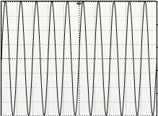
10 trillingen in 1s f = 2 Hz
T = 0,1 s $f=\frac{1}{T}$ $f=\frac{1}{0,1 s}=10 Hz$
f = 10 Hz $T=\frac{1}{f}$ $T=\frac{1}{10 Hz}=0,1 s$
1s

Slide 6
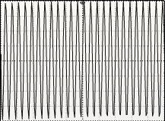
25 trillingen in 1s f = 25 Hz
T = 0,04 s $f=\frac{1}{T}$ $f=\frac{1}{0,04 s}=25 Hz$
f = 25 Hz $T=\frac{1}{f}$ $T=\frac{1}{25 Hz}=0,04 s$
1s

Slide 7
T = 0,0002 s $f=\frac{1}{T}$ $f=\frac{1}{0,0002 s}=50000 Hz=50 kHz$
f = 50 kHz $T=\frac{1}{f}$ $T=\frac{1}{50.000 Hz}=0,0002 s$

Slide 8
Factor tabel 3 Binas
M Mega ${10}^{6} =1.000.000$
k Kilo ${10}^{3} =1.000$
m Milli ${10}^{−3} =1/1.000$
μ Micro ${10}^{−6} =1/1.000.000$

Slide 9
Factor tabel 3 Binas
5 MHz = 5 x ${10}^{6} Hz=$5.000.000 Hz
5 kHz = 5 x ${10}^{3} Hz=$5.000 Hz
5 ms = 5 x ${10}^{−3} s=0,00$5 s
5 μs = 5 x ${10}^{−6} s=0,00000$5 s

